Slide 1
Introduction To Machine Learning
Assignment 2
Eigen faces and Fisher faces
Shivangi Bithel, Yukti Kaura, Vishnu

Slide 2
Index
Assignment Task
Dataset Explanation
EigenFaces For 2 class
Training & Testing images
Mean and Normalized Images
EigenFaces and Test Results
Choice of Threshold
PCA, Choice of K, K-means Clustering plots
EigenFaces for Multiple Classes
FisherFaces for Multiple Classes
Accuracy
Future Work

Slide 3
Assignment Task:
Perform Eigenfaces and Fisherfaces with Training Images
Calculate the Accuracy and plot graphs
Define the Database
Read Training Images and Test Images
Predict the Subject in the test images

Slide 4
Dataset: AT&T Face database
This database contains a set of face images taken between April 1992 and April 1994 at the AT&T Laboratories Cambridge.
There are 10 different images of each of 40 distinct subjects.
the images were shot at different times with different lighting conditions, facial expressions and facial details (glasses/no glasses)
The size of each image is 92x112 pixels, with 256 grey levels per pixel.
Total number of features = 92*112 = 10,304

Slide 5
Eigenfaces for 2 Class

Slide 6
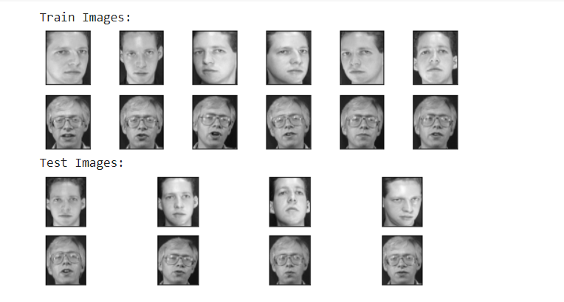
Training(6) & Testing(4) Images

Slide 7
Eigen Faces
Split the available data into train and test set.
From the training set of face images, calculate the eigenfaces, which define the face space using principal component analysis.
When a new face image is encountered, calculate a set of weights based on the input image and the M eigenfaces by projecting the input image onto each of the eigenfaces.
Determine if the image is a face (whether known or unknown) by checking to see if the image is sufficiently close to “face space.”
Classify the weight pattern as either a known person or as unknown.

Slide 8
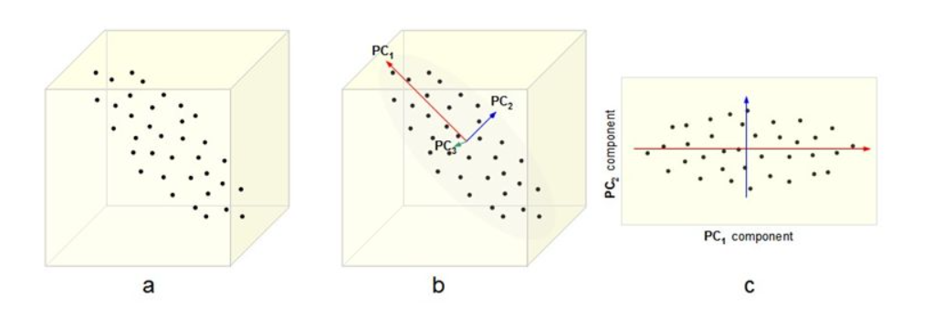
Principal Component Analysis
Principal Component Analysis, is a dimensionality-reduction method that is used to reduce the dimensionality of large data sets, by transforming a large set of variables into a smaller one that still contains most of the information in the large set.

Slide 9
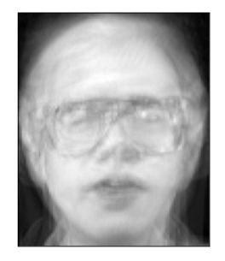
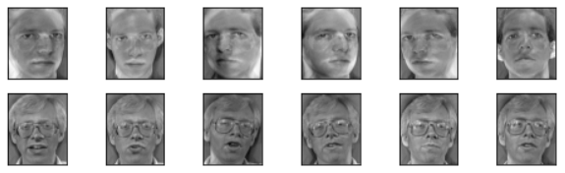
Mean Face & Normalized Training Images

Slide 10
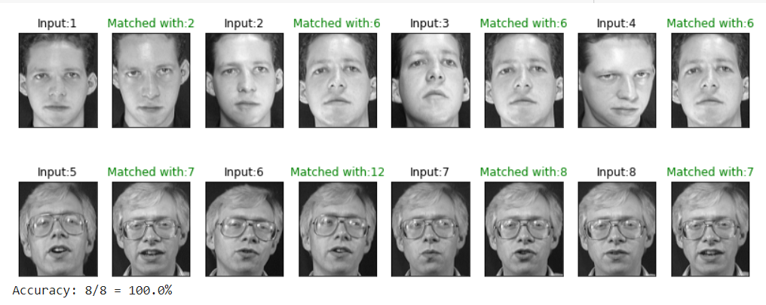
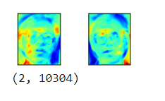
Eigen faces (2 out of 10304) & Results

Slide 11
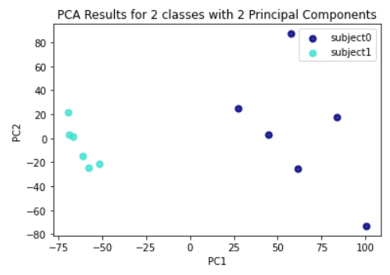
PCA Results

Slide 12
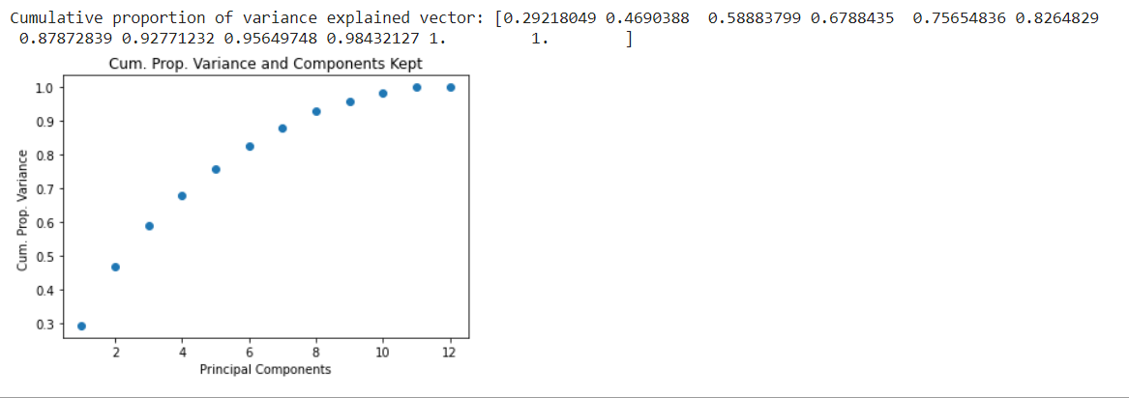
The choice of k

Slide 13
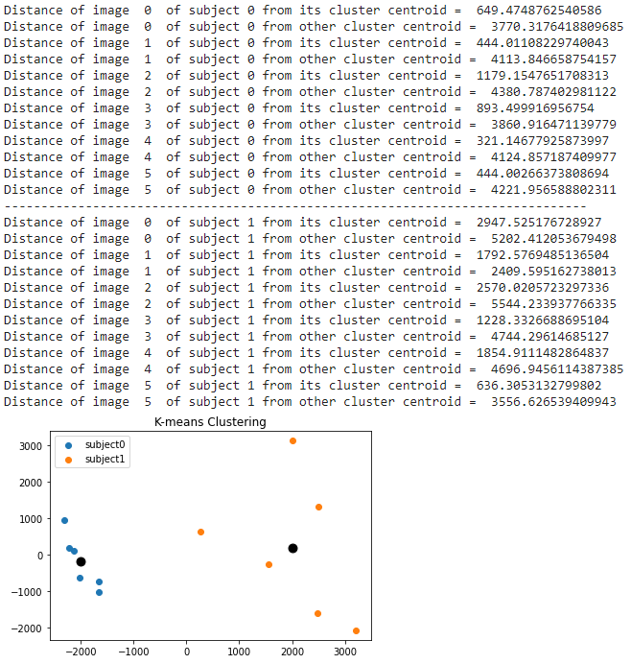
K-Means Clustering

Slide 14
Eigenfaces for Multiple Classes

Slide 15
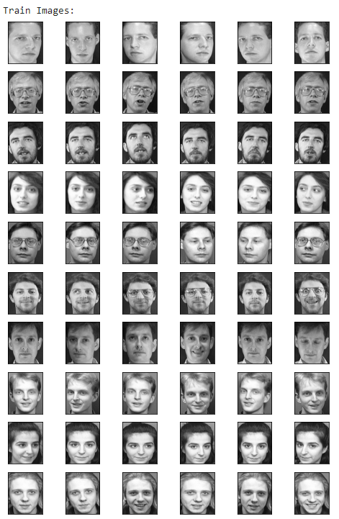
Training Images in case of multiple classes (10 * 6 =60)

Slide 16
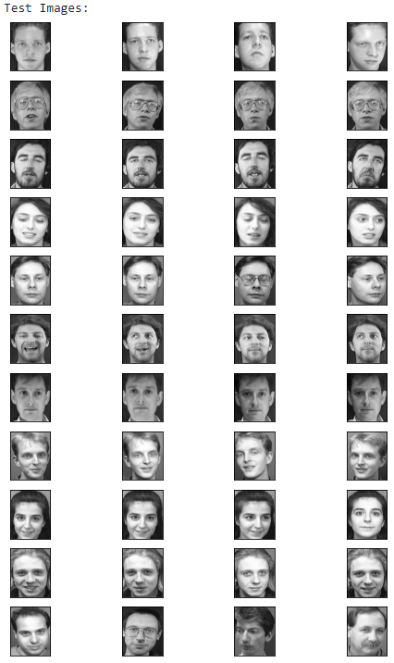
Testing Images in cases of multiple classes (10*4 = 40)

Slide 17
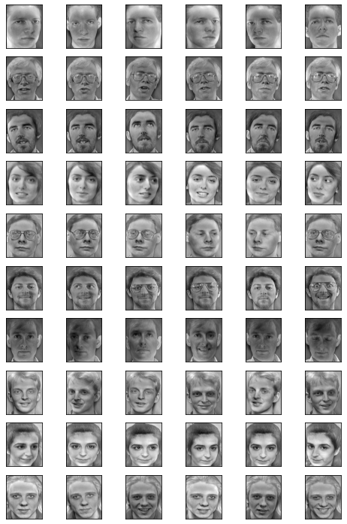
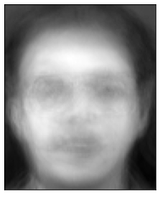
Mean and Normalized Training Images

Slide 18
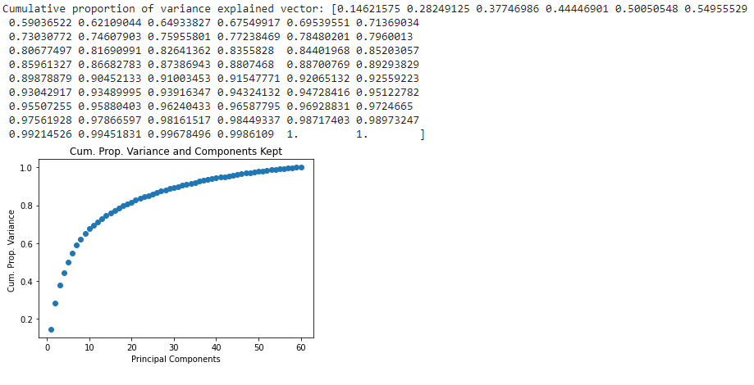
Choice of K

Slide 19
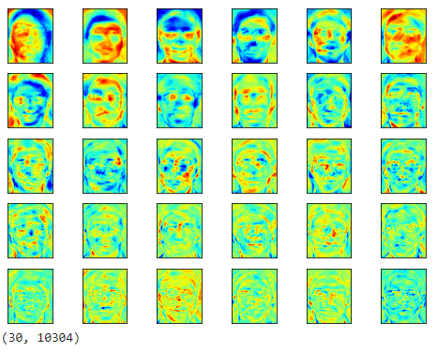
Top 30 Eigen Faces

Slide 20
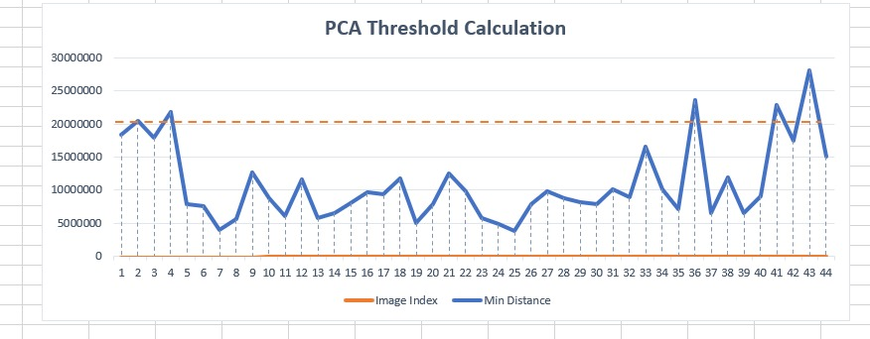
Choice of Threshold

Slide 21
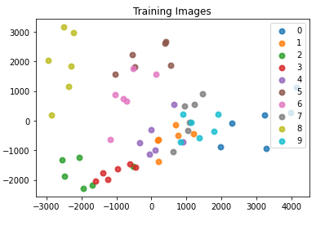
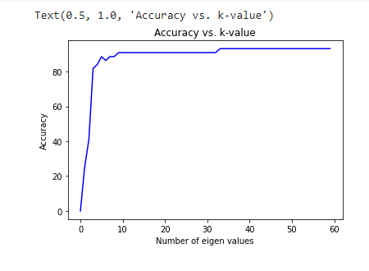
Accuracy vs K-value & K-Means CLustering

Slide 22
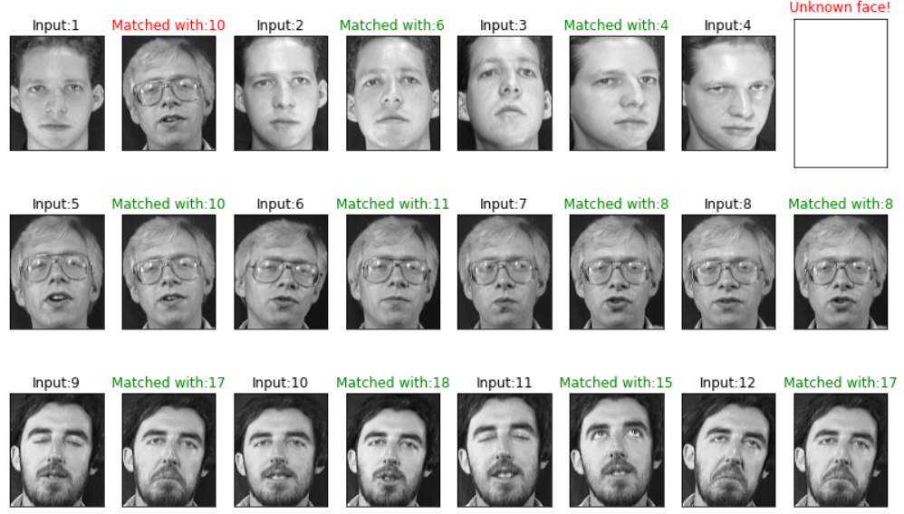
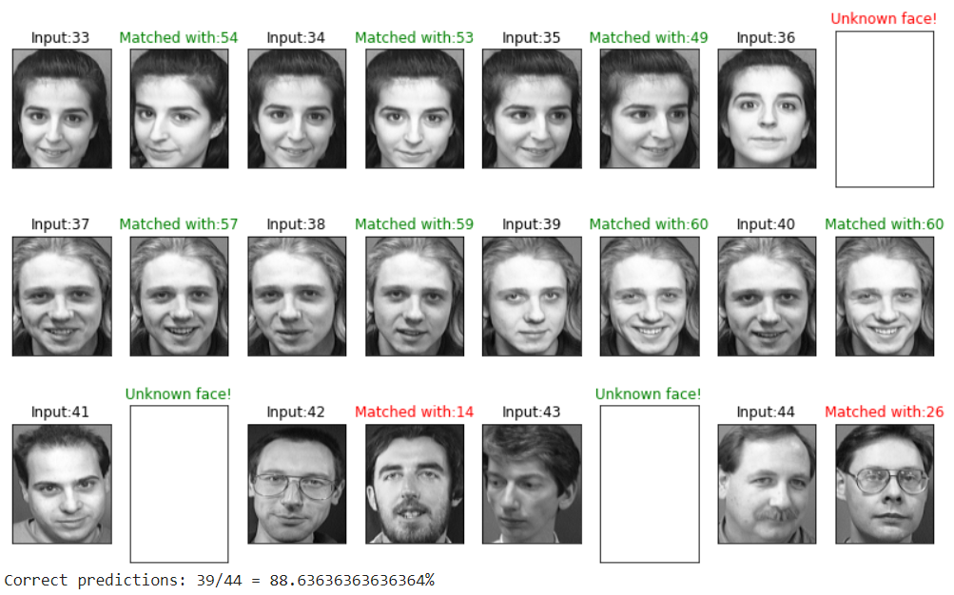
Test Results

Slide 23
Fisherfaces for Multiple Classes

Slide 24
Fisher Faces
Split the available data into train and test set.
From the training set of face images, calculate the eigenvalues, which define the eigenspace using principal component analysis.
Find the mean vectors of each class from the dataset and an overall mean vector of all the training images.
Compute scatter matrices
Between class scatter matrix - S_{B}
Within class scatter matrix - S_{W}

Slide 25
Fisher LDA
J = S_{B} \ S_{W}
Compute the eigenvectors and corresponding eigenvalues for the scatter matrices J
Sort the eigenvectors by decreasing eigenvalues and choose k eigenvectors
W_{FS}= W_{PCA} * Reduced data of LDA
When a new face image is encountered, calculate a set of weights based on the input image and the k fisherfaces by projecting the input image onto each of the fisherfaces.
Determine if the image is a face (whether known or unknown) by checking to see if the image is sufficiently close to “face space.”
Classify the weight pattern as either a known person or as unknown.

Slide 26
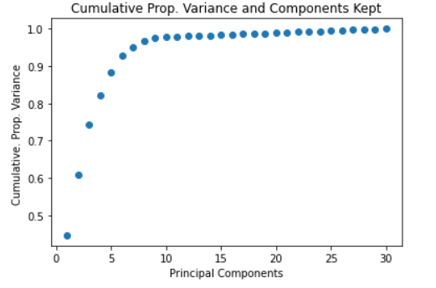
Choice of K

Slide 27
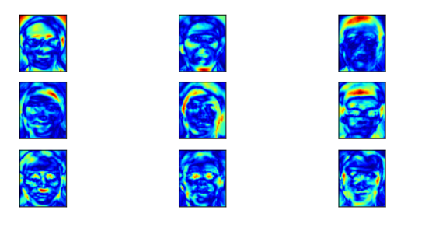
Fisher Faces

Slide 28
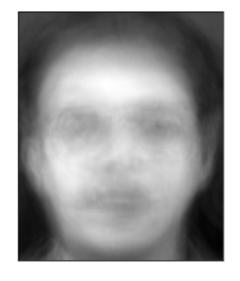
Mean Face & Threshold Calculation

Slide 29
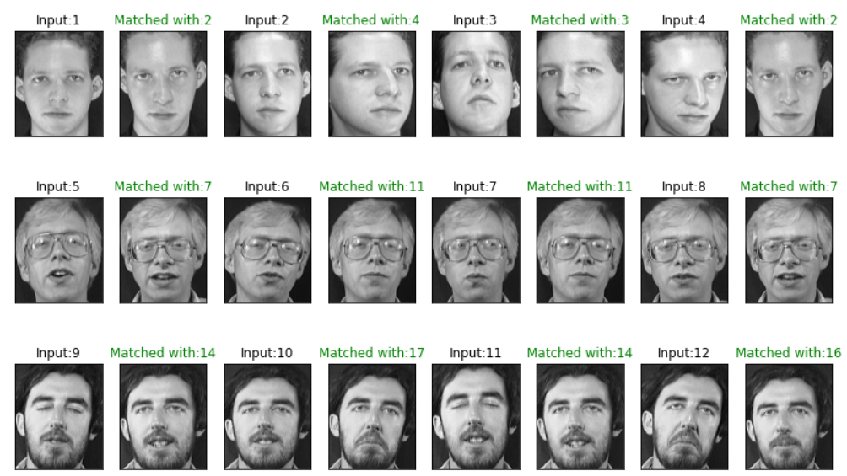
Results

Slide 30
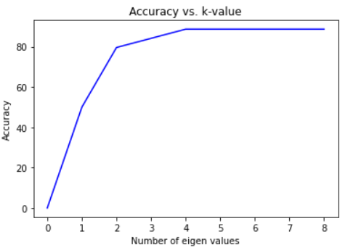
Accuracy vs k-value

Slide 31
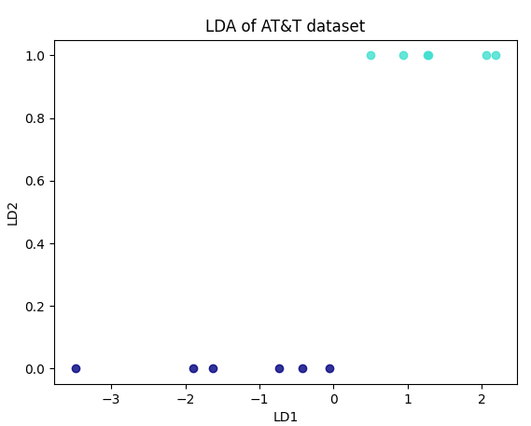
LDA Results for 2 class problem

Slide 32
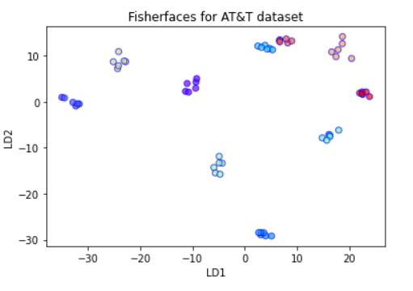
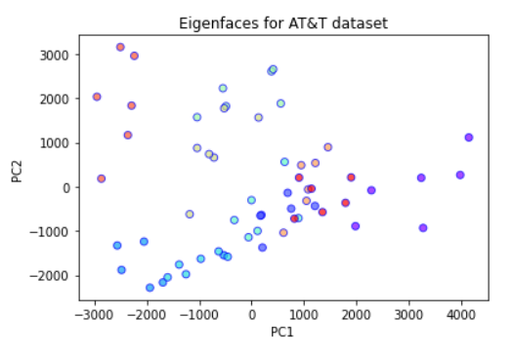
FisherFaces and EigenFaces Projection on Multiclass

Slide 33
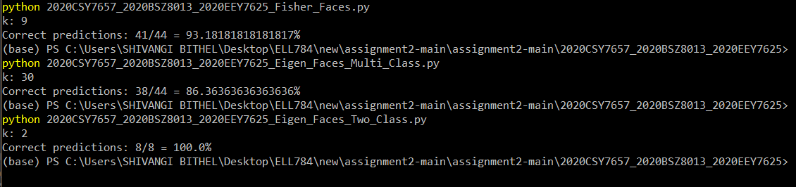
Final Accuracy

Slide 34
Future Work
This work can be extended by doing more number of experiments like building a classifier for glass detection
Further we can include a real time training, incase an image which was not initially available in training and is occurring again and again, weights for such image can be learned and included in the training data.
Face Recognition in videos

Slide 35
THANK YOU :)

